Slide 1
Pet Detector
심하은

Slide 2
목차
개요
Dataset
Model
Training

Slide 3
개요
실시간으로 Segmentation을 수행하는 프로그램 개발
CPU 환경에서 스트리밍 Segmentation 수행

Slide 4
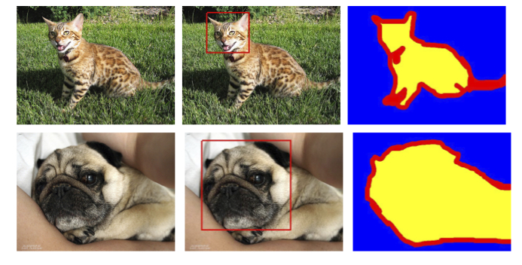
Dataset
The Oxford-IIIT Pet Dataset
Category
0 | Background
1 | Cat or Dog
Size
800MB
https://www.robots.ox.ac.uk/~vgg/data/pets/

Slide 5
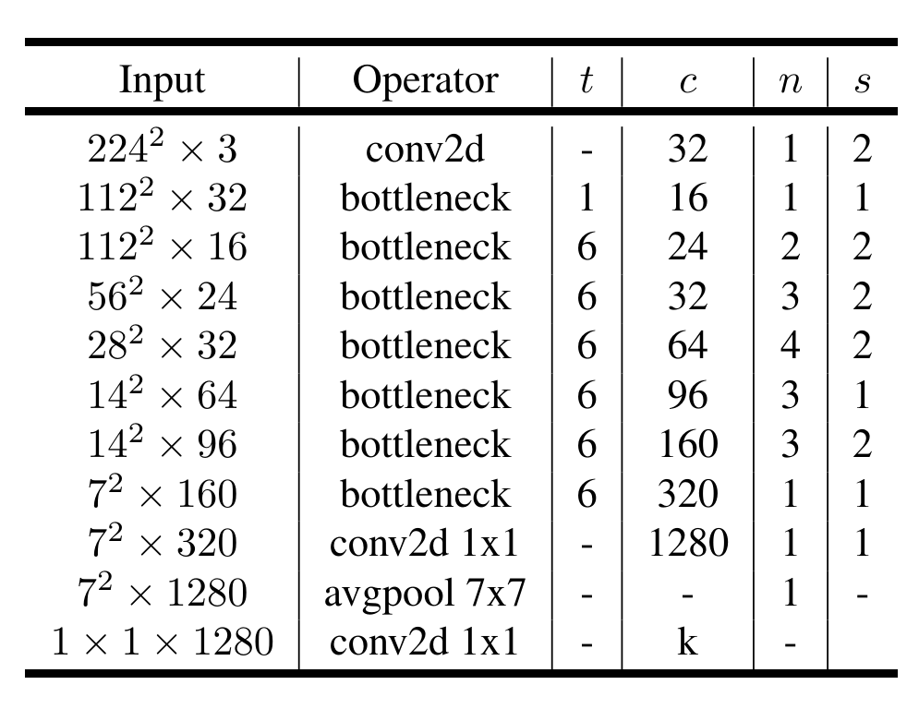
Model
Backbone - Pretrained Mobilenetv2
low-level feature
backbone
https://arxiv.org/pdf/1801.04381

Slide 6
Model
DeepLabv3 +
1×1Conv
3×3Conv,
rate 6
Image
Mobilenetv3
3×3Conv,
rate 12
Concat
3×3Conv,
rate 18
Avgpool & Upsample
1×1Conv & Upsample
low-level
feature
Mask
1×1Conv
Concat
Classification & Upsample
https://arxiv.org/pdf/1802.02611

Slide 7
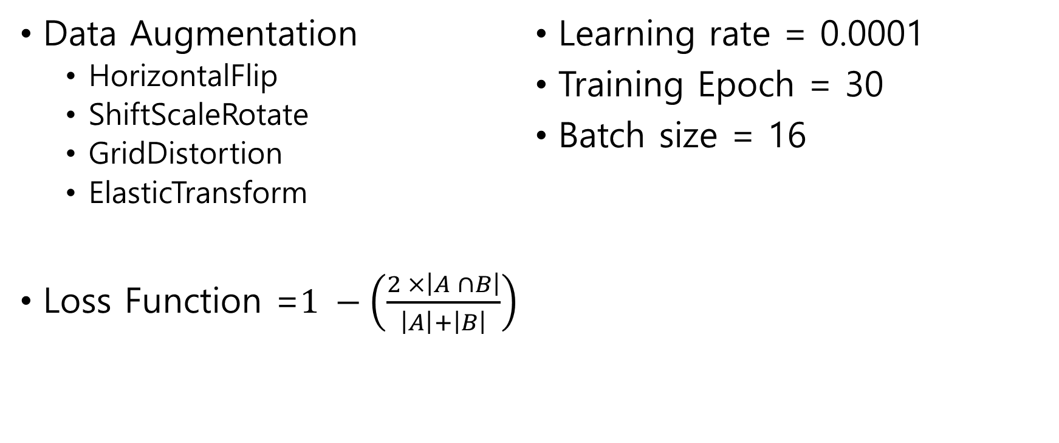
Training
Data Augmentation
HorizontalFlip
ShiftScaleRotate
GridDistortion
ElasticTransform
Loss Function =$1 −\left(\frac{2 ×\left|A ∩B\right|}{\left|A\right|+\left|B\right|}\right)$
Learning rate = 0.0001
Training Epoch = 30
Batch size = 16

Slide 8
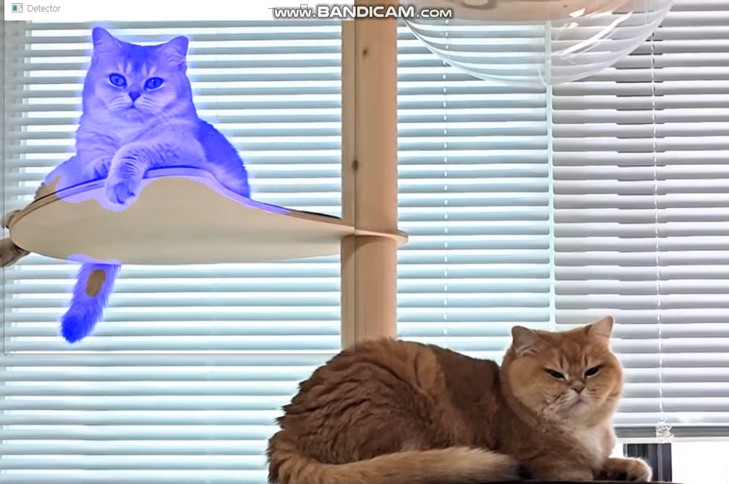
Result

